Slide 1
Advanced Topics in Generative Models
Harish Kashyap: harish@pandita.ai

Slide 2

Harish Kashyap: harish@pandita.ai
An Entrepreneur and an AI SME in machine learning, robotics, big data, Gen AI and signal processing
Over a decade of experience as a researcher across various industries, including Amazon Robotics, KLA Tencor and BBN Technologies
Career highlights include leading the development of AI-driven algorithms that interact with robotic systems
Founder of two companies: Mysuru Consulting Group(MCG) and Pandita AI
GitHub: https://github.com/harishkashyap
LinkedIn: https://www.linkedin.com/in/hkashyap/

Slide 3
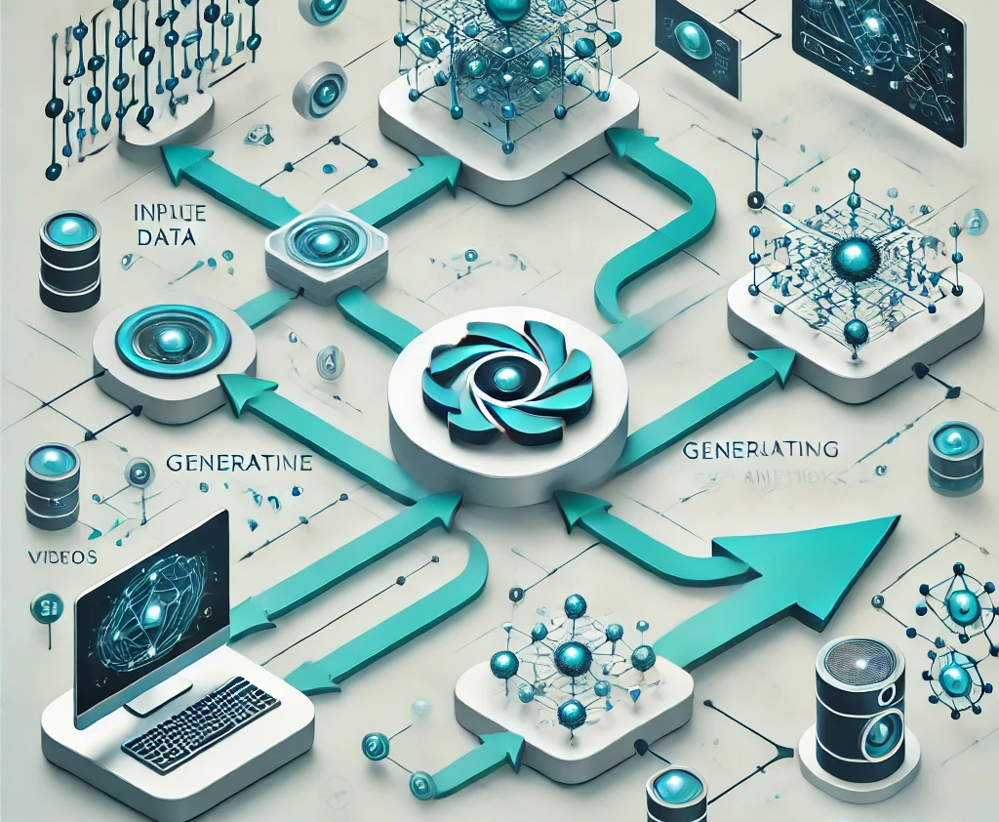
Neural Radiance Fields (NeRFs)
What are Generative Models?
Machine learning models that generate new data similar to the training data.
Applications: Image generation, video synthesis, 3D modeling.
What is Neural Radiance Fields (NeRFs)?
A state-of-the-art technique for generating 3D scenes and novel views.
Key Features:
High-quality 3D reconstruction.
Novel view synthesis from sparse input images.

Slide 4
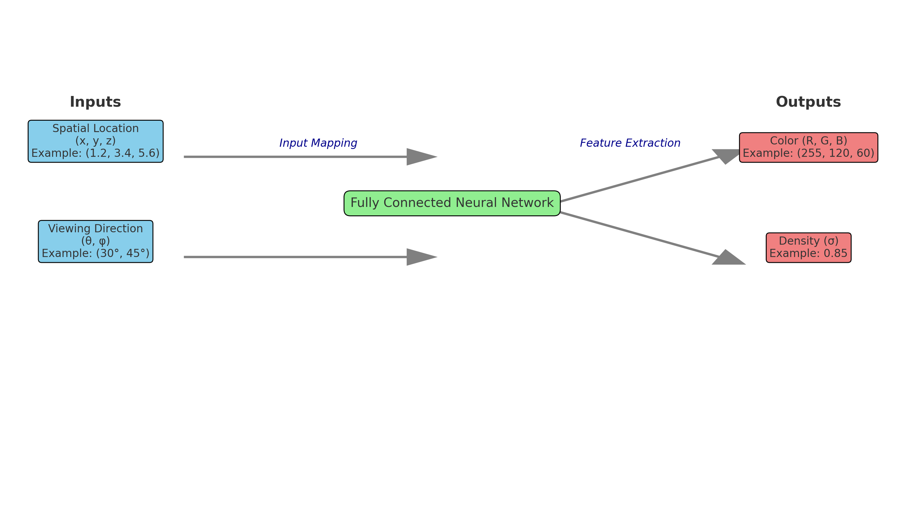
Idea of NeRF
Input to NeRF:
Spatial Location (x, y, z): 3D position in space.
Viewing Direction : Angle of observation.
Output from NeRF:
Color (R, G, B): RGB values for rendering.
Density (σ): Light absorption at the location.
Mechanism:
Fully connected neural network maps inputs to outputs.
Trained to minimize rendering loss for accurate scene reproduction.

Slide 5
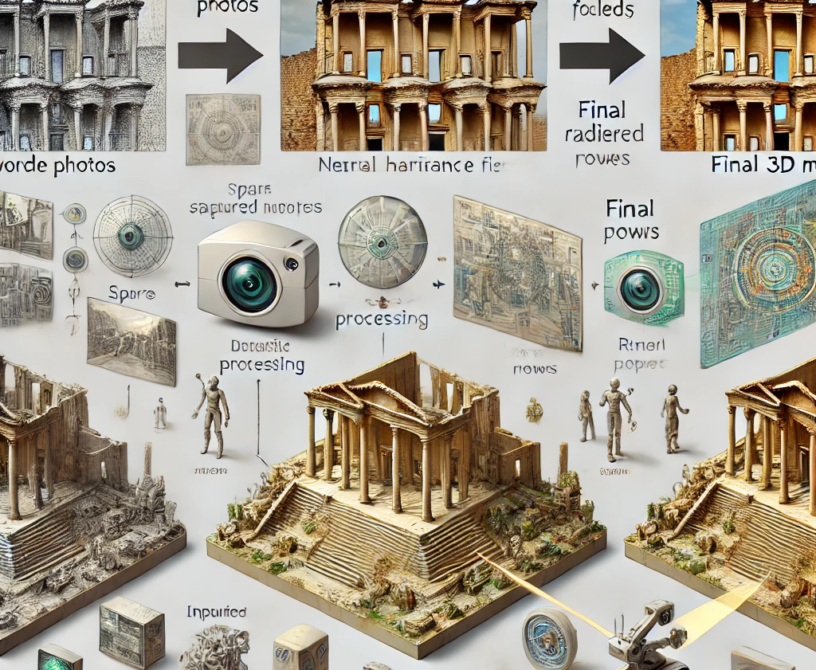
Applications of NeRF
3D Scene Reconstruction: Applications: Cultural heritage preservation, architecture, urban planning.
Example: Detailed reconstructions of historical sites for virtual access.
Novel View Synthesis: Generate realistic views from sparse input images.
Applications: Immersive gaming, photo tours, and virtual tourism.
Industry Use Cases:
Matterport: Virtual property walkthroughs​.
Robotics: Autonomous robots navigating with 3D environmental mapping.
E-commerce: Realistic 3D product visualization.

Slide 6
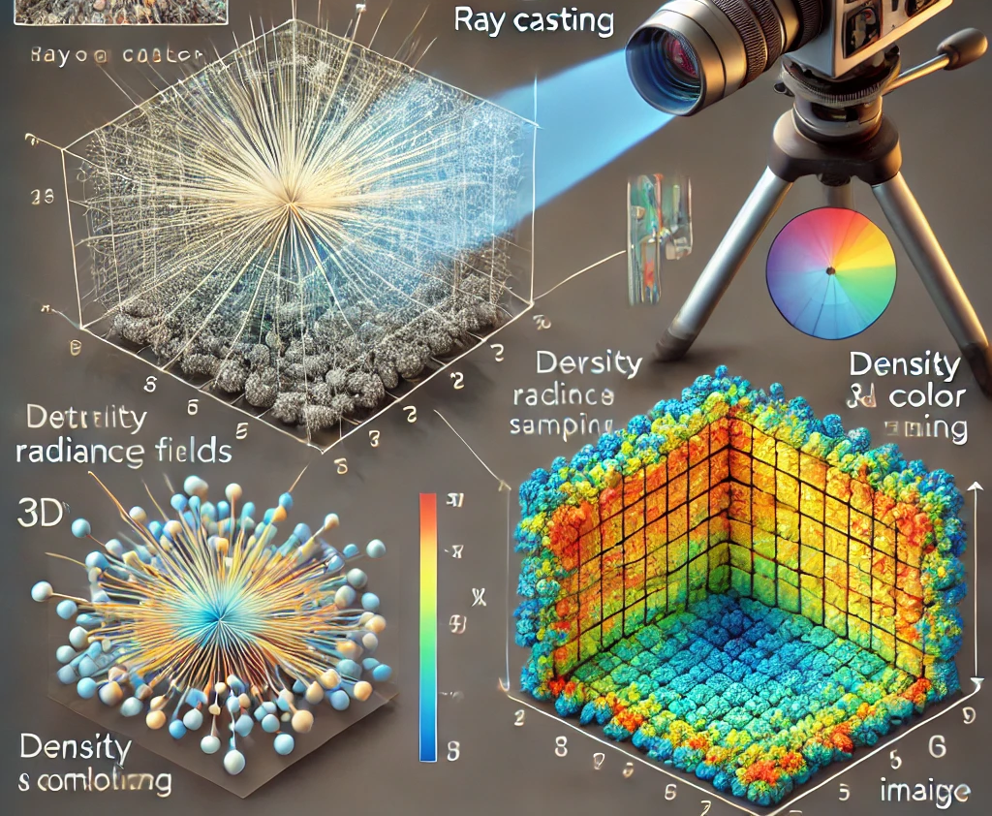
Volume Rendering in NeRF
Purpose:
Converts density (σ) and color (R,G,B) predictions into photo-realistic images.
Integrates values along rays for continuous scene rendering.
Key Steps:
Ray Casting:
Rays are projected through the 3D volume, defined by spatial location (x,y,z) and viewing direction (θ,φ).
Sampling:
At discrete points along each ray, NeRF predicts density (σ) and color (R,G,B).
Integration:
Accumulated density and color values along the ray form the pixel color.
Key Properties:
Handles occlusion and transparency in scenes.
Differentiable rendering ensures gradients optimize the neural network during training.
Applications:
Realistic rendering for sparse input views.
Generates novel perspectives with seamless transitions.

Slide 7
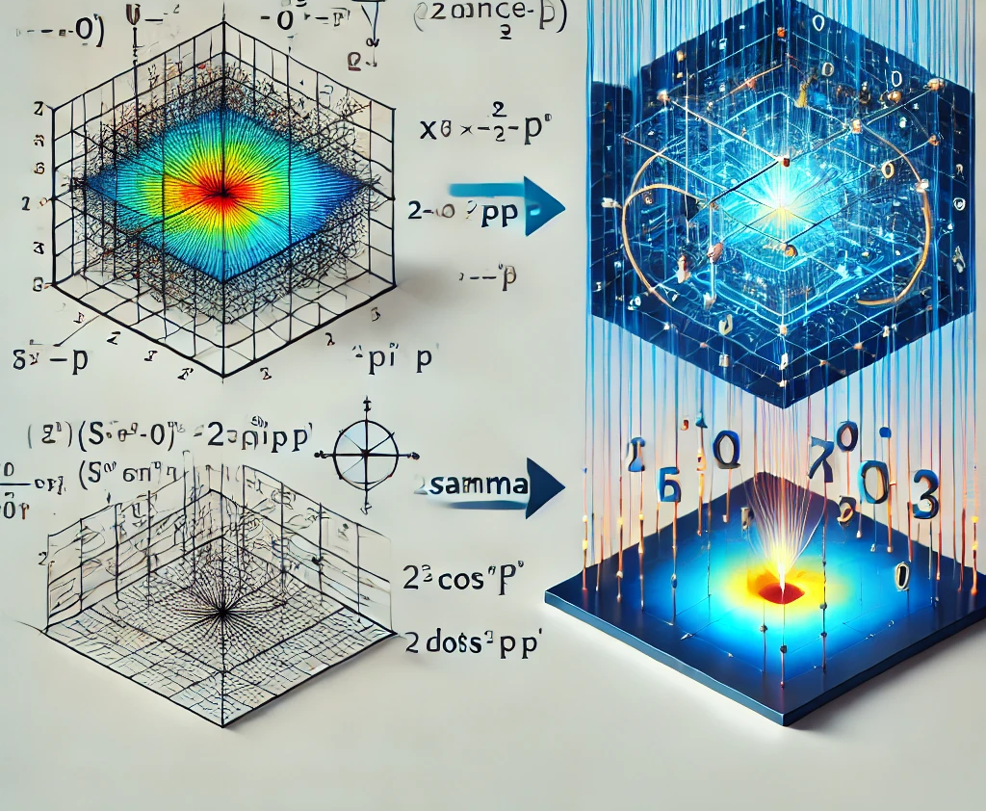
Positional Encoding in NeRF
Why Positional Encoding?
Neural networks struggle with high-frequency details in low-dimensional inputs.
Positional encoding maps inputs to a higher-dimensional space to address this limitation.
How It Works:
Applies sinusoidal functions to spatial locations (x,y,z) and viewing directions
Key Benefits:
Captures sharp edges and textures for better 3D reconstruction.
Reduces blurring and artifacts in synthesized views.
Improves overall scene realism.
Impact:
Makes NeRF scalable for complex and high-resolution 3D scenes.
Enables photo-realistic rendering for applications like VR/AR.

Slide 8
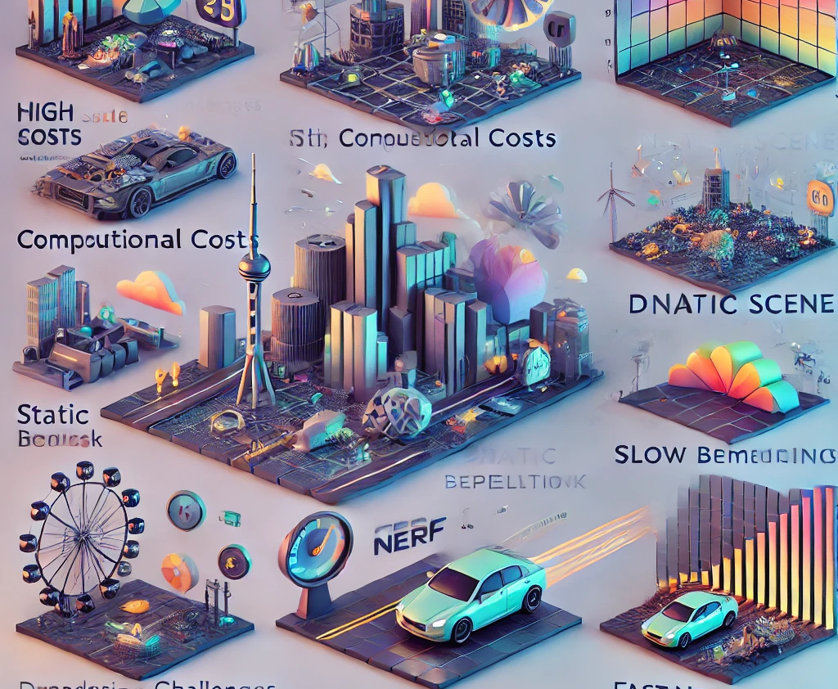
Challenges and Future Directions for NeRF
Challenges
High Computational Costs: Intensive training and rendering demands.
Static Scene Limitations: Struggles with dynamic objects and temporal changes.
Scalability Issues: High memory requirements for large-scale environments.
Rendering Speed: Slow performance for real-time applications.
Future Directions
Efficiency: Real-time NeRF (e.g., FastNeRF, PlenOctrees) for interactive rendering.
Dynamic Scenes: Extensions for moving objects and video synthesis.
Scalability: Handling large environments with models like Mip-NeRF.
Applications: AR/VR, autonomous systems, and cinematic effects.

